Slide 1

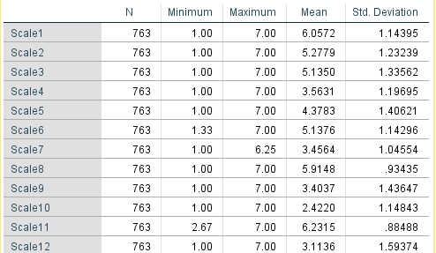
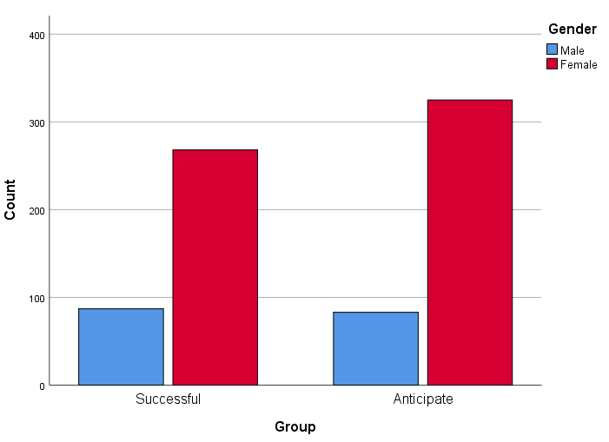
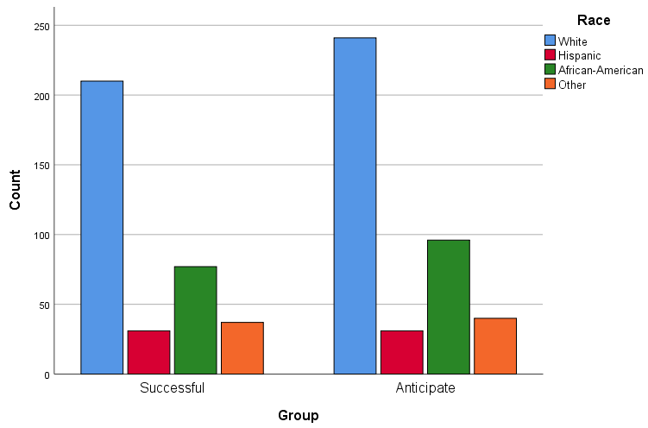
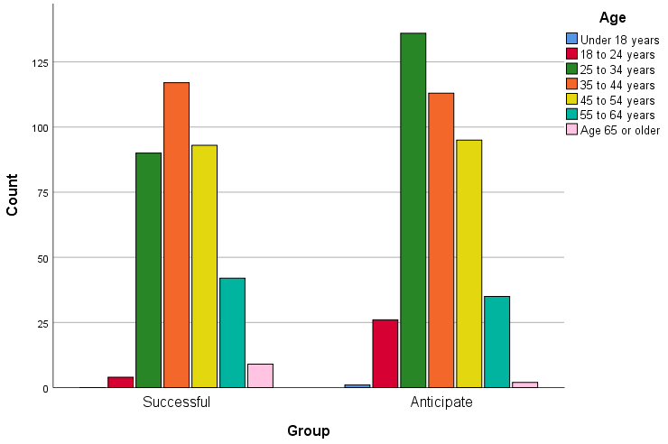
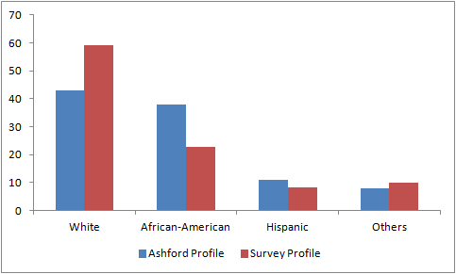
Environmental Attitudes of Online University Students
Clifford Blizard, Ph.D. & Srabasti Dutta, Ph.D.
Division of General Education, Ashford University
Logo
Logo
Introduction
Methods
Results
Conclusions
Environmental scientists have long recognized the extent to which the everyday actions of human beings are having dramatic and devastating impacts on Earth’s climate and ecosystems. In order to mitigate these challenges, environmental educators strive to promote awareness of and concern for the fate of our environment among the public. One key component of this task entails determining how other humans actually feel and act in regarding climate change, pollution and ecological destruction. Collecting and analyzing data on human feelings about the environment enables educators to develop and modify environmental study curricula in an endeavor to enhance levels of concern for the environment, and thus encourage more pro-environmental behaviors (Pooley & O’Connor, 2000). According to Milfont & Duckitt (2010, p.80), an environmental attitude is “a psychological tendency expressed by evaluating the natural environment with some degree of favour or disfavour.”
In order to measure environmental attitudes, Milfont and Duckitt (2010) developed the Environmental Attitudes Inventory (EAI), a survey instrument that considered 12 scales: enjoyment of nature, support for interventionist conservation policies, environmental movement activism, conservation motivated by anthropogenic concern, confidence in science and technology (to solve environmental problems); environmental fragility; altering nature (a belief that humans ought to do this); personal conservation behavior; human dominance over nature; human utilization of nature; eco-centric concern; and support for population growth policies. The EAI was later optimized by Sutton and Gyuris (2013) so that it maintained all 12 dimensions while asking fewer 7-point Likert scale questions (37 vs. 72).
The purpose of this investigation was to evaluate the environmental attitudes of undergraduate students enrolled in Ashford University, using the Environmental Attitudes Inventory as revised by Sutton and Gyuris (2013). As such, this is the first published study to focus on the environmental outlook of students in a fully online university context. In particular, we sought to determine the extent to which students’ perspectives on the environment may have been affected by completing an introductory level General Education course in environmental studies (SCI207, ”Our Dependence upon the Environment”). We also investigated possible relationships between students’ environmental attitudes and their demographic characteristics, specifically, gender, age, and race. Ashford meets the needs of a diverse population of largely non-traditional learners, including many who come from economically disadvantaged backgrounds and/or are first-generation college students. All Ashford students are required to meet certain core competencies; SCI207 fulfills the Scientific Reasoning Competency, and is the only course students can take in order to accomplish this task.
In this age of numerous regional and global environmental challenges, it is vital that schools support students in developing the environmental knowledge, awareness, and concern to take on the role of socially responsible and engaged citizens. Developing a baseline for the extent to which Ashford’s environmental science course is fostering such attitudes of concern provides an invaluable starting place for efforts to make future changes to the course in order to promote this goal.
An invitation to complete the Environmental Attitudes Inventory (EAI) of Sutton and Gyuris (2013) was emailed to all currently enrolled Ashford University students. Students who opted to participate in our study were asked to rank each item using a 7 point Likert Scale (strongly disagree, disagree, somewhat disagree, neither agree nor disagree, somewhat agree, agree and strongly agree). The survey also included demographic questions related to age, race, marital status, gender and military status. A total of 763 students answered all the questions of the survey, out of which 355 students had successfully completed SCI207 and the other 408 anticipated taking the class in future. In all, 170 male students and 593 female students completed the EAI. The various demographics of the respondents are provided in the graphs below. Note that the distribution of respondents by race/ethnicity did not closely match the that of Ashford University as a whole (see Figure 4).
Descriptive Statistics
The descriptive statistics for all of the participants are shown in the following table. Higher sample means (x>5) were obtained for Scales 1, 2, 3, 6, 8, and 11. These results indicate that the respondents in this sample generally valued nature for its own sake. Students also scored low on those scales that support dominating nature and using it for our own needs.
This investigation sought to characterize the environmental attitudes of students attending Ashford University, an online institute of higher learning serving majority minority non-traditional students (Institutional Research Services, 2016). In particular, researchers examined the possible impacts of SCI207, a General Education course in environmental studies, on respondents’ environmental outlooks. In general, respondents valued nature for its own sake and did not support using nature for our own purposes or controlling it. Because this is the first known study to evaluate environmental attitudes at an online university, it is difficult to compare these findings with those of other institutions. As one example, Koc and Kuvac (2016) used the EAI to assess preservice science teachers in a Turkish university; students scored high for enjoyment of nature, environmental movement activism, and environmental fragility.
The only statistically significant differences between EAI respondents who had taken SCI207 and those who had not yet done so pertained to attitudes about our right to alter nature for our own benefit, and conserving nature for our own purposes; in both cases, respondents who had taken the course showed a slight shift in favor of nature having value apart from its usefulness to humans. This did not, however, translate into statistically significant differences in environmental behaviors or level of ecocentric concern.
In order to identify possible confounding factors in this study, we evaluated demographic differences between respondents (gender, age, race). In regard to gender, mean male score was statistically higher than the mean female score in four cases. Bogner and Wiseman (2004) found that boys tended to score higher in the utilitarian domain that supports the mastering nature and valuing nature as it satisfies human needs. We obtained similar results, as males scored higher in altering nature and human dominance over nature; males also showed greater confidence in science and technology than females, along with greater support for population growth policies.
Several statistically significant differences emerged in regard to race/ethnicity. African-Americans generally showed a lower level of enjoyment in nature, support for conservation policies, confidence in science and technology, support for population growth policies, and ecocentric concern than other racial groups. These findings reflect those of Johnson, Bowker, and Cordell (2004) who reported that African Americans tended to score lower on the New Environmental Paradigm survey than most other ethnic groups. It should be noted, however, that racial demographics of the respondents did not match that of Ashford as a whole, as shown in Figure 4.
Overall, the findings of this study are preliminary; more investigation is clearly warranted. One area not addressed here was respondents’ socioeconomic status; it is quite possible that this played a role in determining which students opted to invest time in completing the survey as well as shaping their attitudes. Also, this study included all students who had taken SCI207, regardless of how long ago they had done so; in order to identify changes in environmental attitude resulting directly from the course, it would be helpful to offer the EAI as a pre- and post-survey directly to students enrolled in it. Results of this study will be used to provide guidance for a course redesign, currently slated for May of 2018. Planned changes include addition of a self-reflective journal component with required nature experience and the addition of an environmental footprint reduction activity promoting sustainable everyday behaviors.
Scale 1 -- Enjoyment of nature
Scale 2 -- Support for conservation policies
Scale 3 -- Environmental movement activism
Scale 4 -- Conservation motivated by anthropocentric concern
Scale 5 -- Confidence in science and technology
Scale 6 -- Environmental fragility
Scale 7 -- Altering nature
Scale 8 -- Personal conservation behavior
Scale 9 -- Human dominance over nature
Scale 10 -- Human utilization of nature
Scale 11 – Eco-centric concern
Scale 12 -- Support for population growth policies
Environmental Attitudes and SCI207
Respondents were divided into two groups: “successful” (those who completed the SCI207 course), and “anticipate” (those who plan on taking it in the future). Independent Sample T-Tests were conducted on the following hypotheses: H₀: Mean of successful group = mean of anticipate group; H_{a} : the means are different. Statistically significant results were obtained for Scale 4 (conservation motivated by anthropocentric concern) and Scale 7 (altering nature). The successful group mean score for Scale 4 of 3.4704 was -0.173 ± 0.087 [mean ± standard error] lower than the anticipate mean score of 3.6438, t(761) = -2.00, p = 0.046. The successful mean score of 3.3063 for Scale 7 was -0.28 ± 0.075 [mean ± standard error] lower than the anticipate mean score of 3.5870, t(761) = -3.730, p = 0.000. These findings indicate that successful students were less likely to support conservation for purely human benefit, and were less likely to support altering nature for human purposes, than anticipate students.
Figure 1. Number of EAI respondents who completed SCI207 vs. those who anticipate taking SCI207 in the future, by gender.
Environmental Attitudes and Gender
Independent Sample T-Tests were conducted to find out if there were any significant environmental attitude differences between males and females. For each of the four statistically significant scales, the mean male score was higher than the mean female score: confidence in science and technology (Scale 5), altering nature (Scale 7), human dominance over nature (Scale 9) and support for population growth policies (Scale 12).
Figure 2. Number of EAI respondents who completed SCI207 and anticipate taking the class in the future, by race.
Environmental Attitudes and Age
Analyses showed that none of the scales showed any statistical significance in regard to age. Thus, we failed to reject the null hypotheses.
Figure 3. Number of EAI respondents who completed SCI207 and anticipate taking the class in the future, by age.
Environmental Attitudes and Race
In terms of race/ethnicity, scales 1, 2, 6, 11 and 12 showed statistical significance, and thus we rejected the null hypothesis for each one. Post-hoc analyses indicate that the difference lies between African-American and White, African-American and Hispanic, and African-American and other races. African-Americans score lower on all but scale 11, where other races scored lower.
Bibliography
Bogner, F.X., & Wiseman, M. (2004). Outdoor ecology education and pupils’ environmental perception in preservation and utilization. Science Education International, 15, 27-48.
Institutional Research Services, Ashford University (2016). Institutional data. Retrieved from http://assessment.ashford.edu/behind-numbers/institutional-data/enrolled-student-characteristics#/28/149
Johnson, C. Y., Bowker, J. M., & Cordell, H. K. (2004). Ethnic variation In environmental belief and behavior: An examination of the New Ecological Paradigm in a social psychological context. Environment and Behavior, 36(2), 157-186.
Koc, I., & Kuvac, M. (2016). Preservice Science Teachers' attitudes toward environment. International Journal of Environmental and Science Education, 11(13), 5925-5941.
Milfont, T.L. & Duckitt, J. (2010), The environmental attitudes inventory: a valid and reliable measure to assess the structure of environmental attitudes. Journal of Environmental Psychology, 30(1), 80-94.
Pooley, J. A., & O'Connor, M. (2000). Environmental education and attitudes: Emotions and beliefs are what is needed. Environment and Behavior, 32(5), 711-723.
Sutton, S. G., & Gyuris, E. (2015). Optimizing the environmental attitudes inventory. International Journal
of Sustainability in Higher Education, 16 (1), 16-33.
Figure 4. Percentages of EAI respondents by race/ethnicity compared with the race/ethnicity distribution of Ashford University as a whole.

